Slide 1
Data science for business
Hamid Zehtab

Slide 2
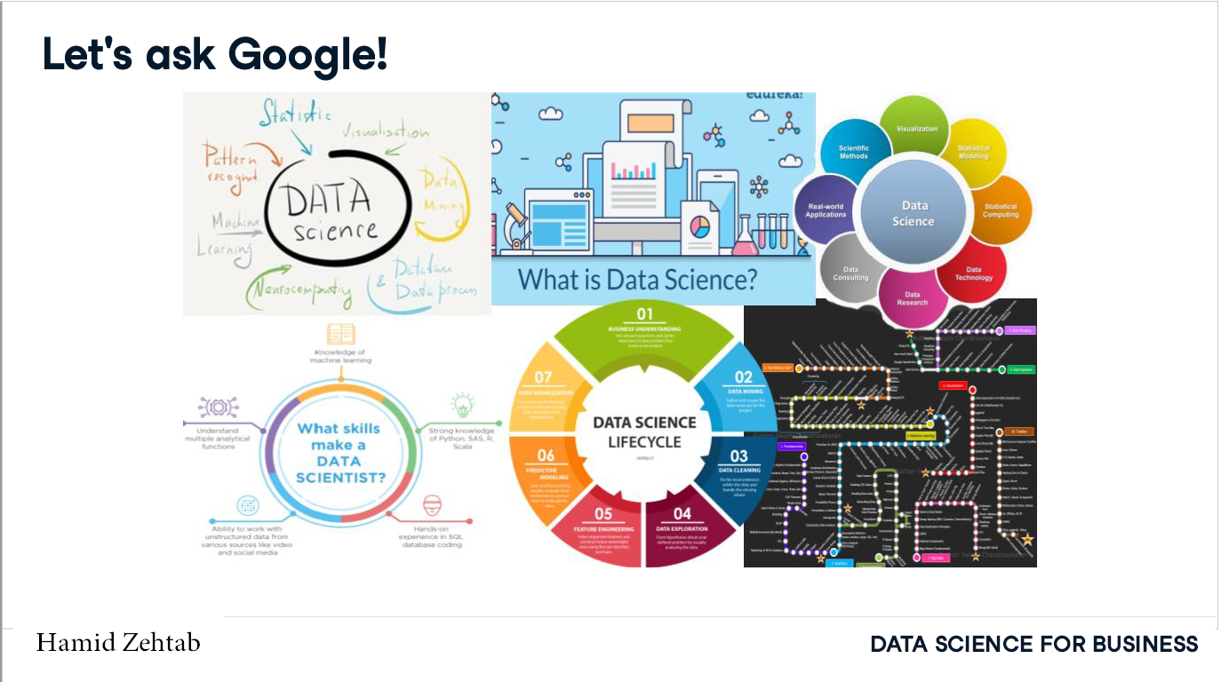

Slide 3
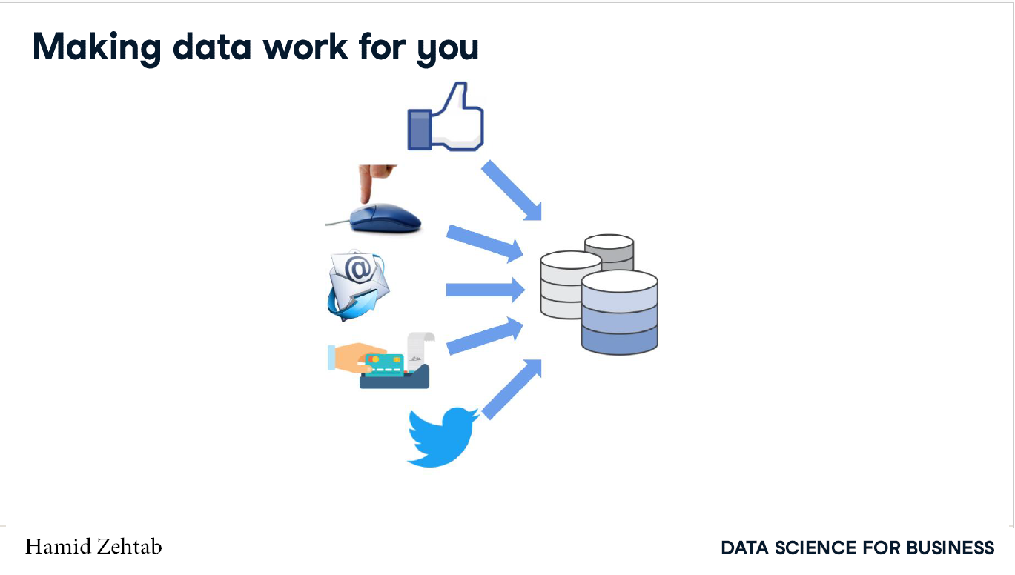

Slide 4
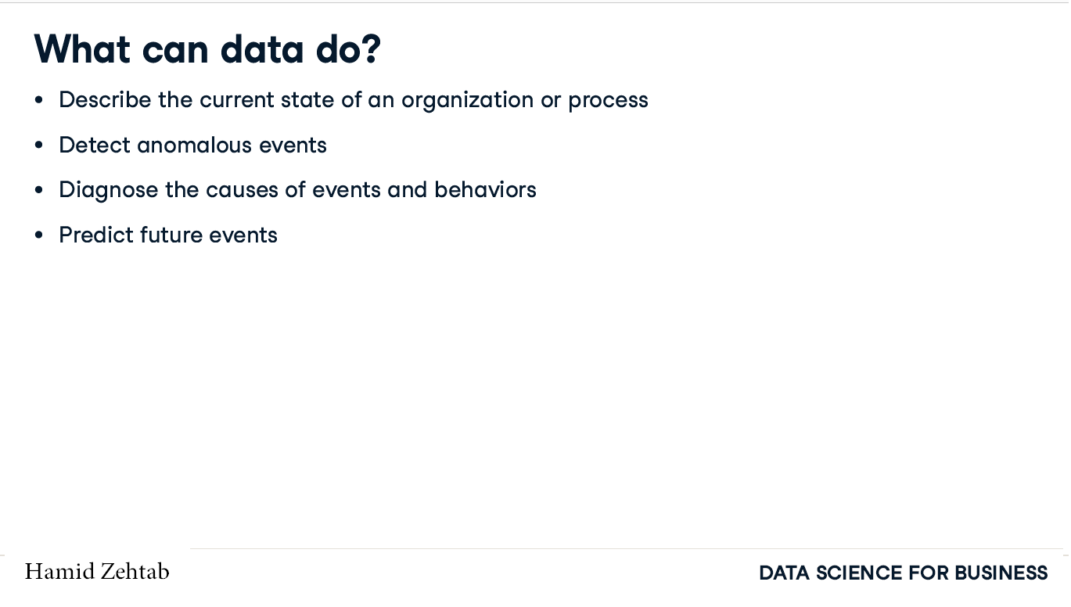

Slide 5
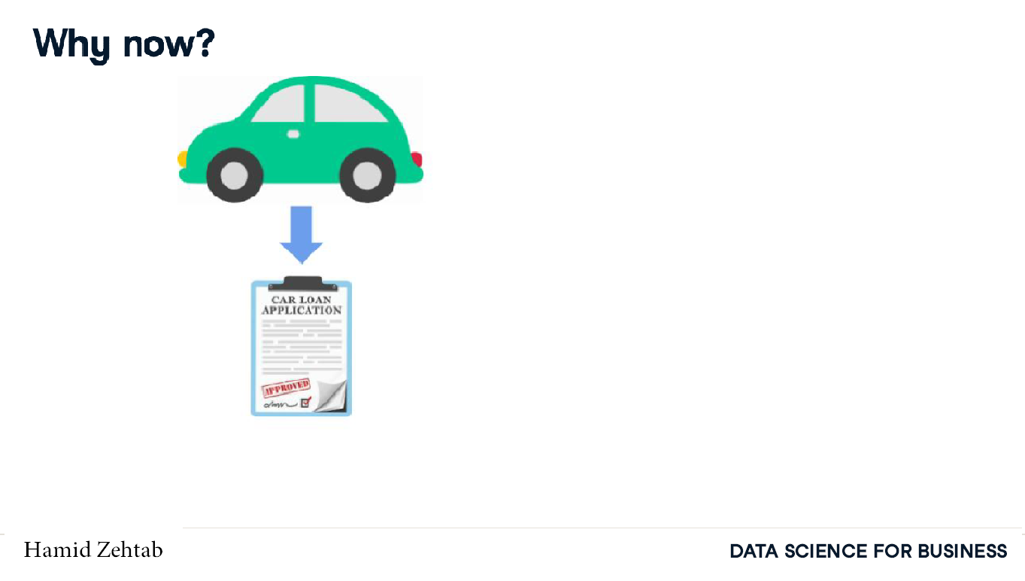

Slide 6
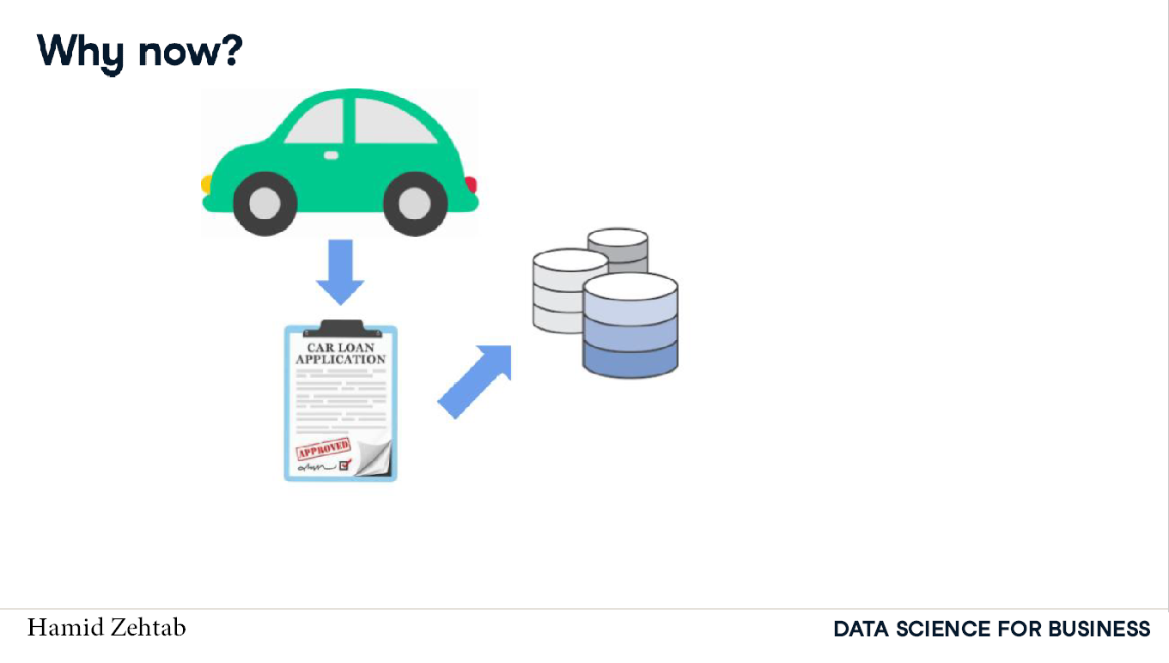

Slide 7
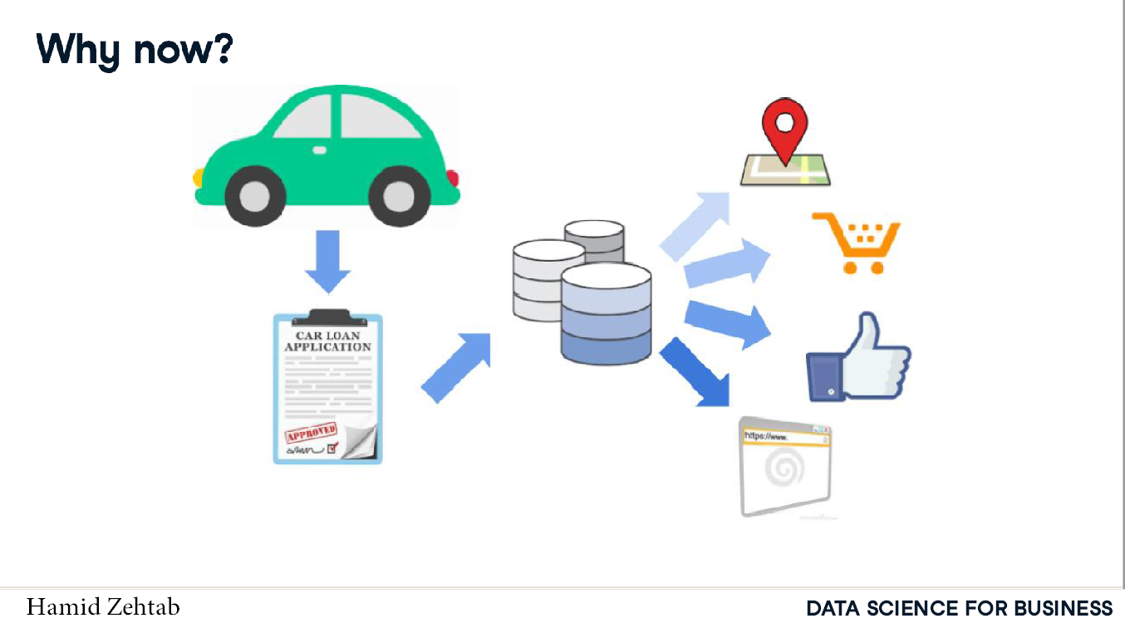

Slide 8
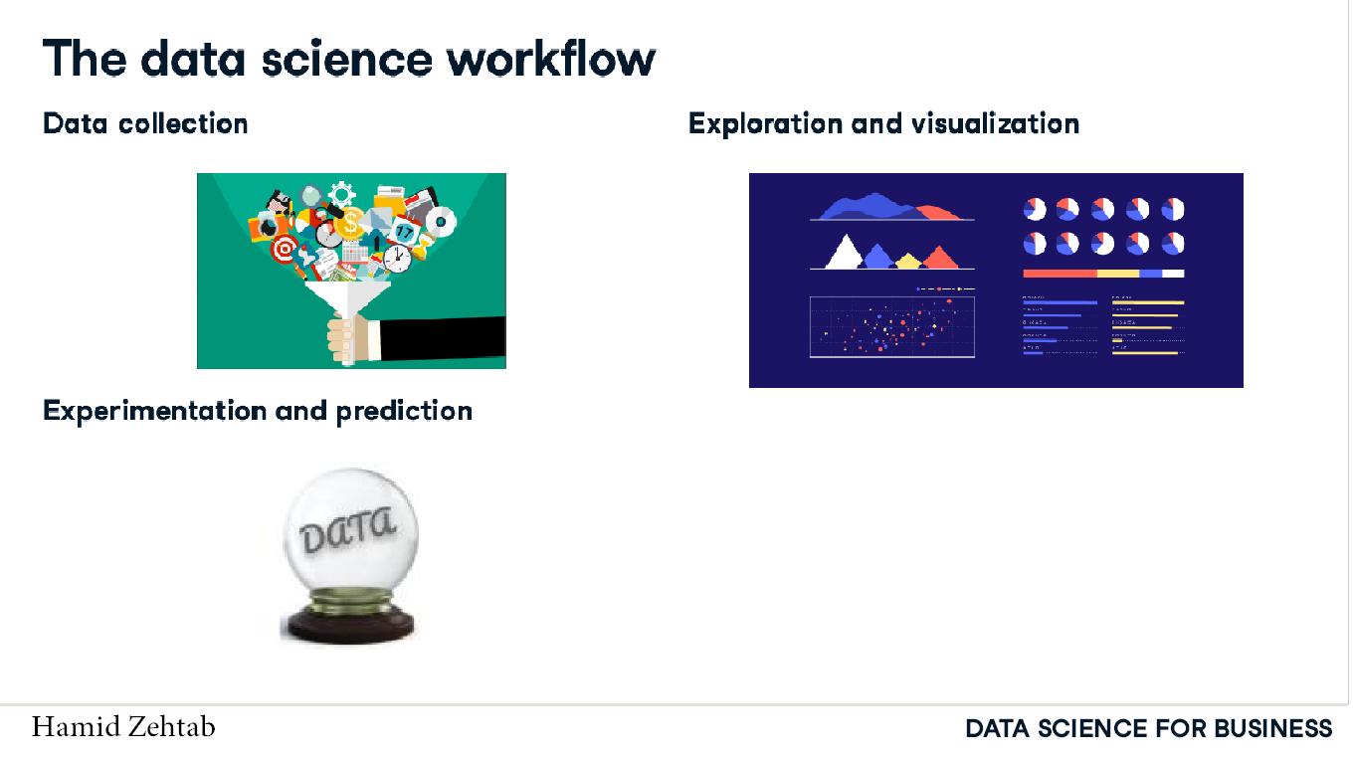

Slide 9
Applications of Data science

Slide 10
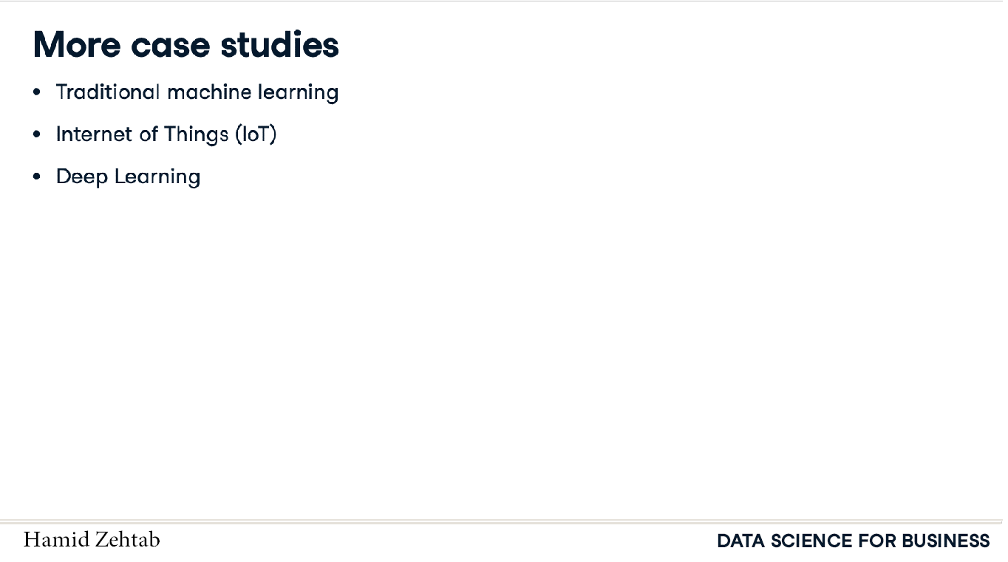

Slide 11
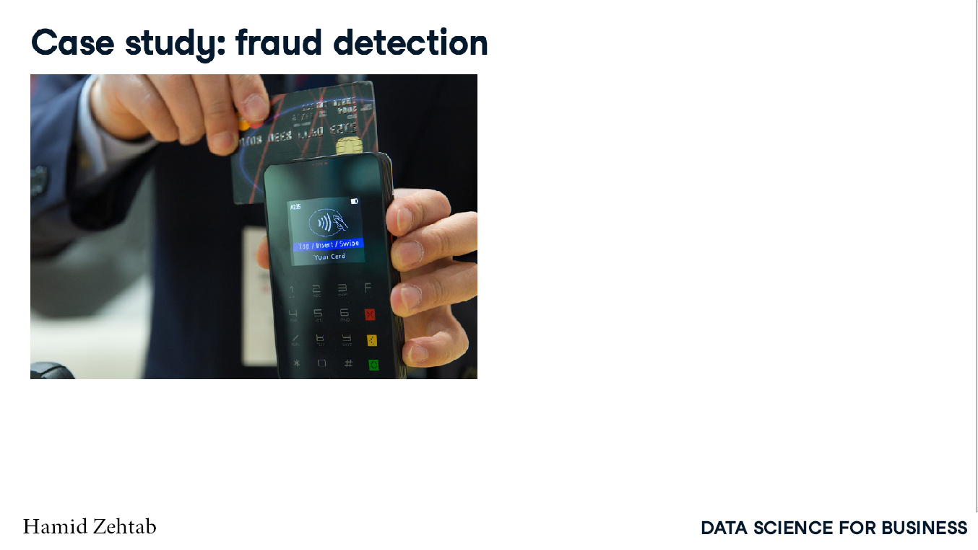

Slide 12
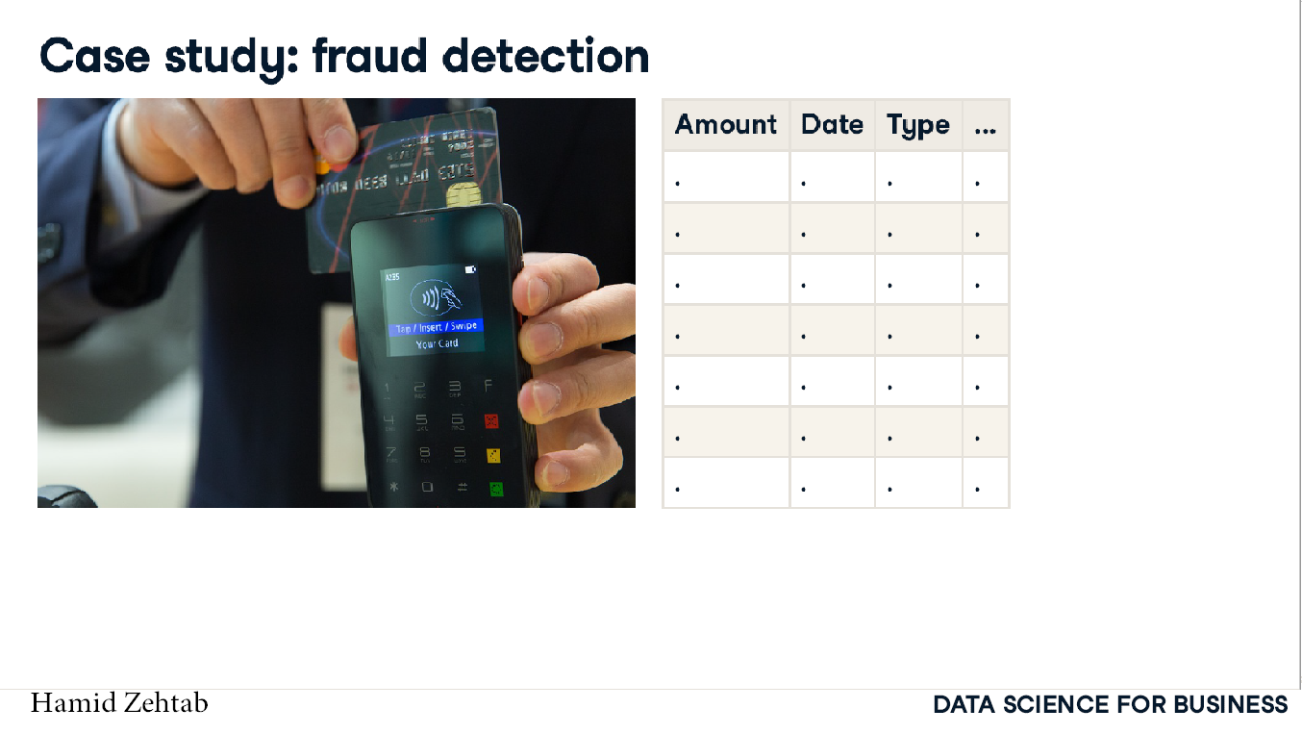

Slide 13
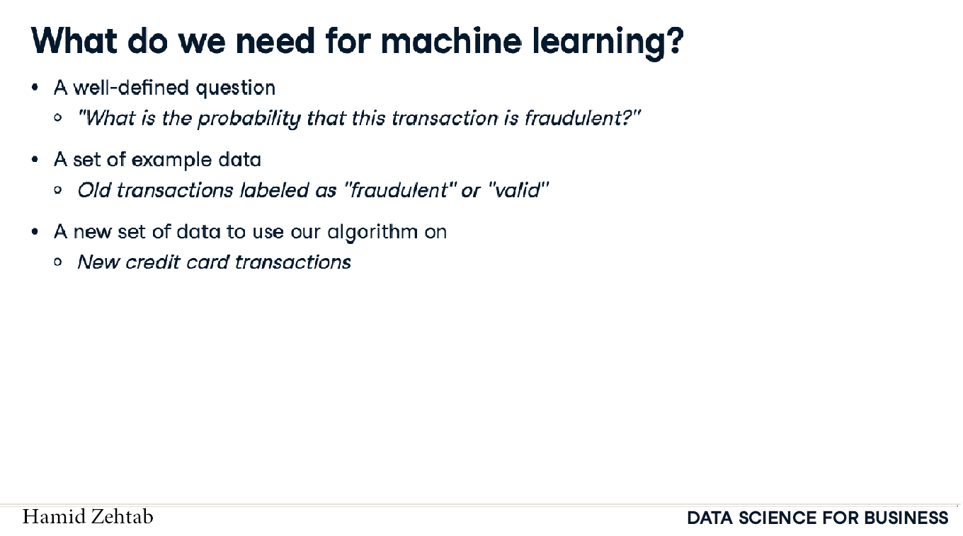

Slide 14
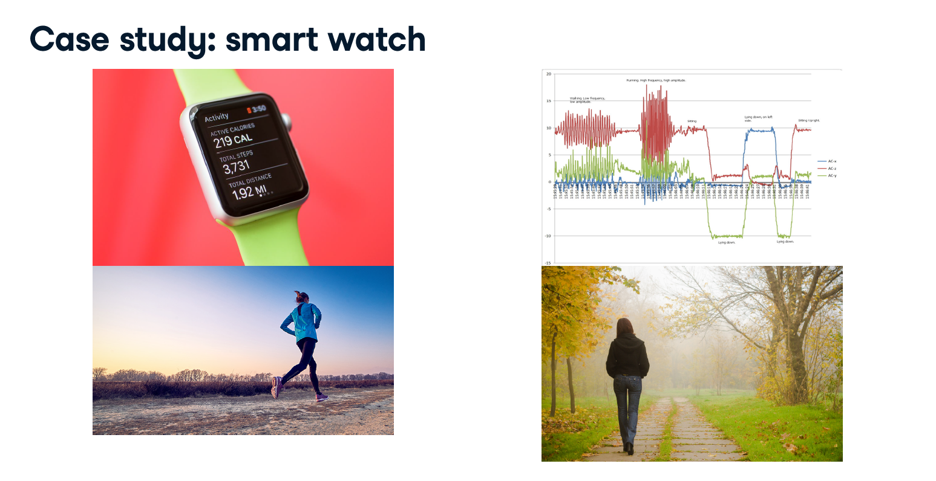

Slide 15
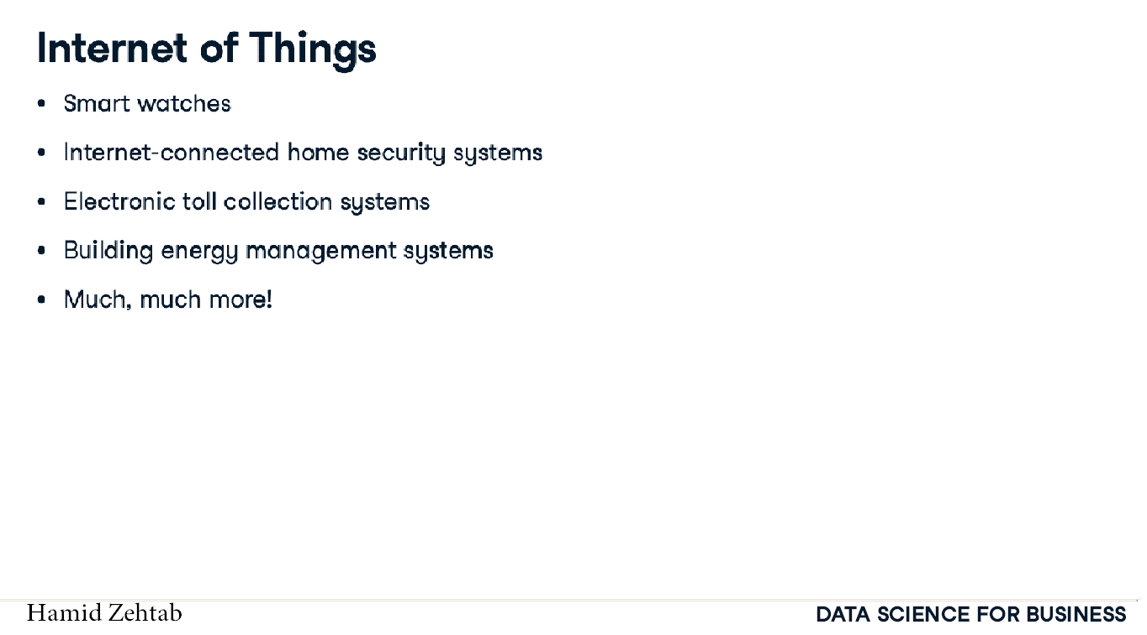

Slide 16
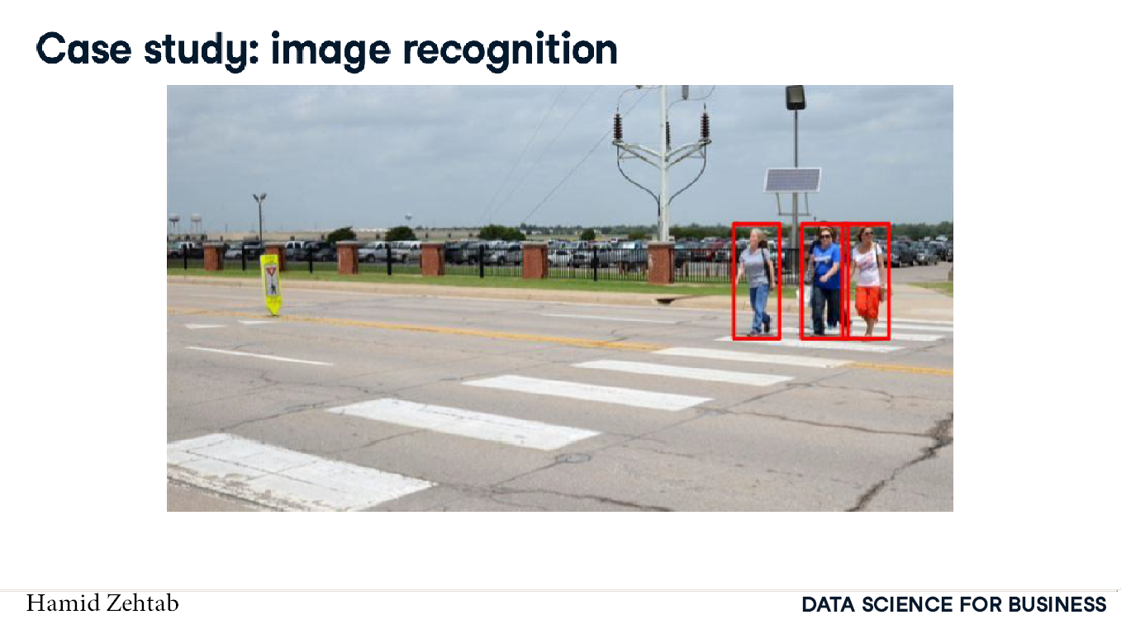

Slide 17
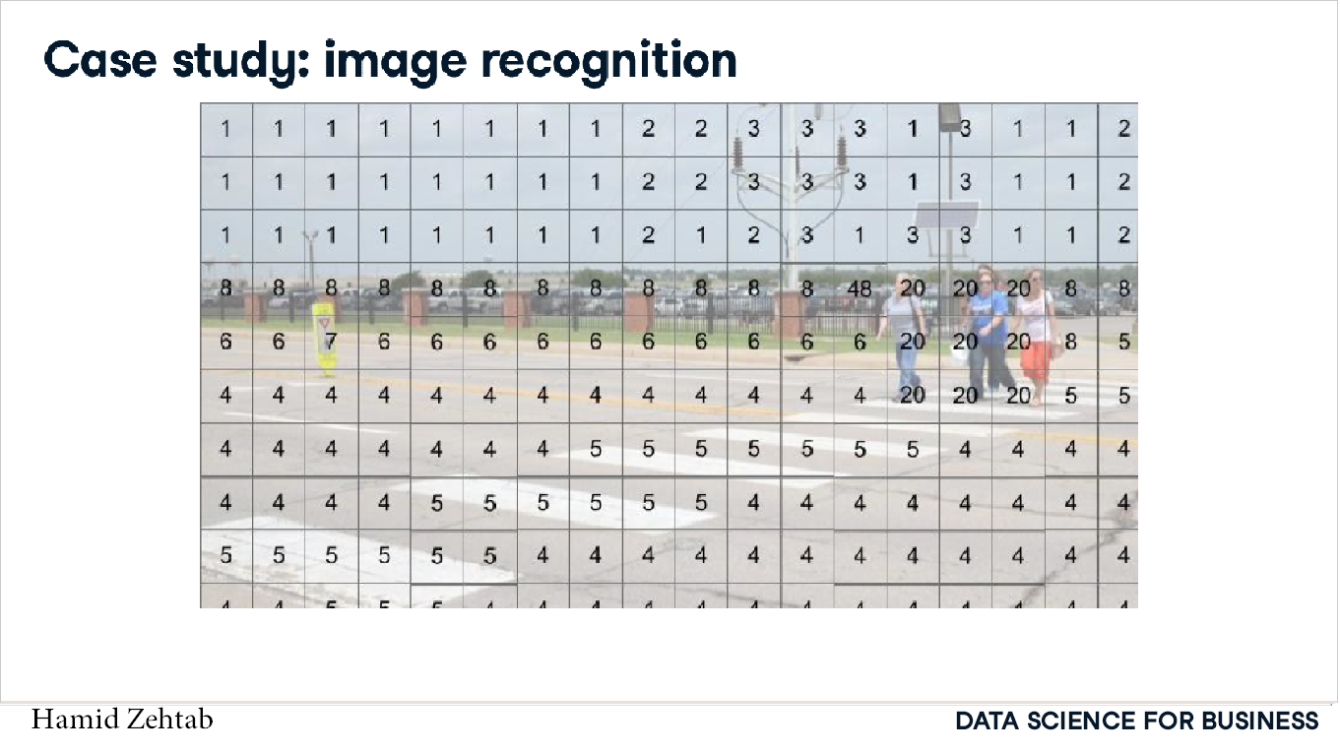

Slide 18
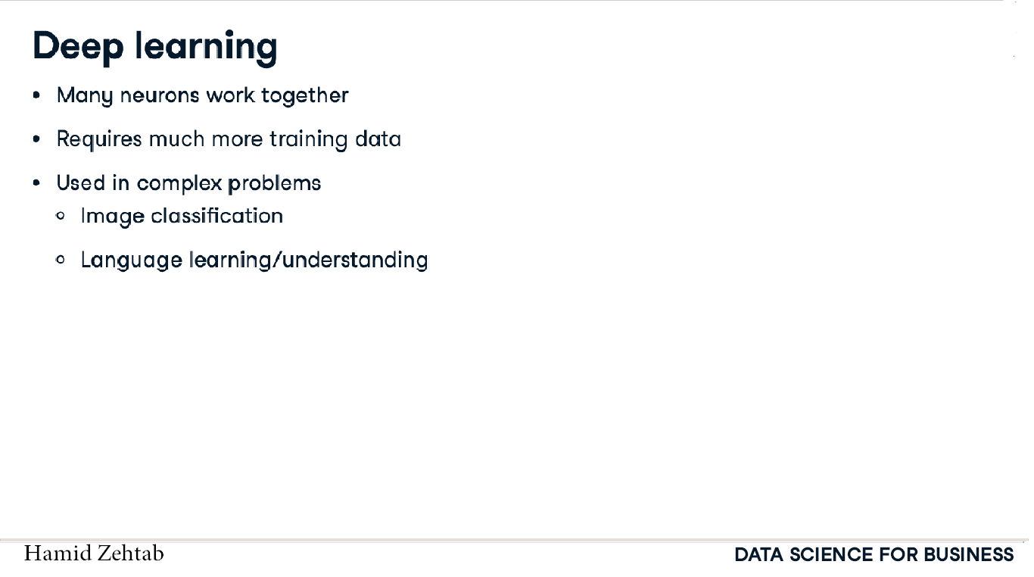

Slide 19
Resources
Data Science for Business and Decision Making by Luiz Favero and Patrícia Belfiore
Harvard Business School at online.hbs.edu
Harvard Business Review at hbr.org
wikipedia.org
ibm.com/cloud/learn/data-science-introduction
coursera.org/browse/data-science

